Slide 1


Introduction to Microsoft Dynamics Customer Relationship Management
Notes:
This course is designed to provide you with a general overview of the capabilities of Microsoft Dynamics CRM 2013.
I will cover the following topics:
An Overview of Dynamics CRM
Working with Dynamics CRM
Processes & Functional Scenarios
And finally – Working with Data

Slide 2


Microsoft Dynamics CRM Agenda
What is Microsoft Dynamics CRM ?
Why Microsoft Dynamics CRM ?
Deployment Option in CRM ?
OOB Microsoft Dynamic CRM ?
Modules of Dynamic CRM ?
Dynamic CRM various Versions ?
Security Model of Microsoft CRM?
Technologies Supporting Microsoft CRM ?
Microsoft CRM Database Structure
Example
Notes:
We will look at
The basic functional areas
The deployment options
The difference between forms, fields, records and entities
How the entity relationship model works
And Navigating Dynamics CR

Slide 3










What is Microsoft Dynamics CRM
Microsoft Dynamics CRM is a business software application that allows companies of all sizes to track, manage, and report on customer interactions to help businesses automate and streamline various operations, such as financial analysis, customer relationships, supply chain management, manufacturing, inventory, human resources, and so on.
Service
Sales
Marketing

Slide 4



Modules of Microsoft CRM
Sales
Marketing
Customer Care

Slide 5
CRM Functional Areas
Sales
Marketing
Customer Care
Marketing Lists
Campaign
Leads
Opportunities
Order
Quote
Invoice
Cases
Contacts
Account

Slide 6
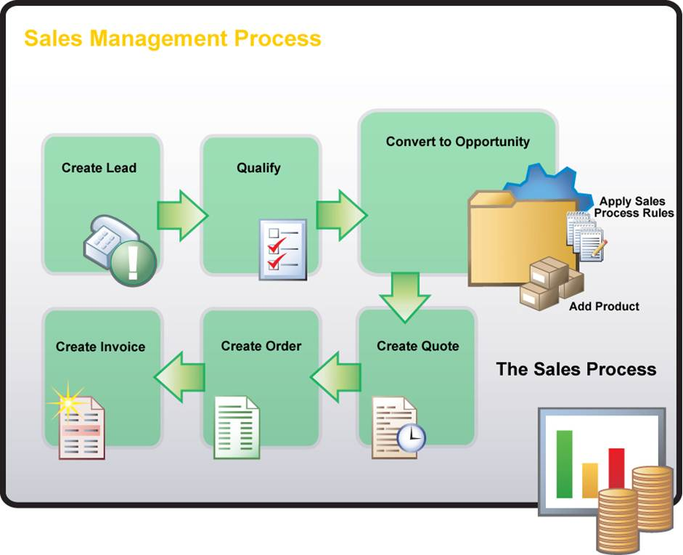
Sales Process

Slide 7
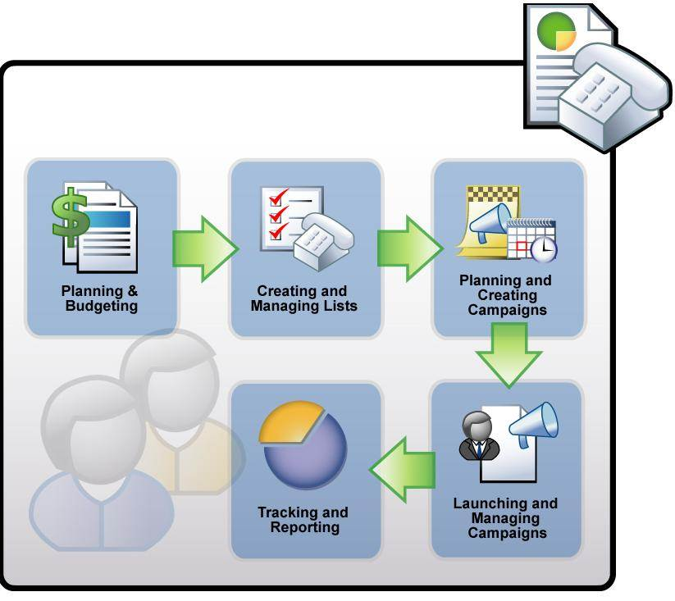
Marketing Process

Slide 8

Customer Care Process
(Service Process)

Slide 9




















Why Why Microsoft Dynamic CRM ?
Microsoft Product
Dynamicity
Three Deployment Option
On Cloud
Language Support
Access Clients
.Net Development Platform
Scalable Architecture
Processing Costs
Ease to use or Less Complex
Organization-wide
Centralized CRM system
Example: ACME, Inc
Work Teams
Small collaboration groups
Example: ACME Account Team
Corporate Divisions
By geography and product line
Example: ACME European Operations
Work Departments
Line of business functions
Example: ACME Customer Service

Slide 10



Deployment Options in Microsoft CRM On-Premise OnCloud/OnLine Partner Hosted
Live (OnLine)
Partner Hosted
On-Premise
Dynamic CRM

Slide 11




Deployment Clients of Microsoft CRM ?
Web Client
Outlook Client
Mobile & Tablet Client

Slide 12
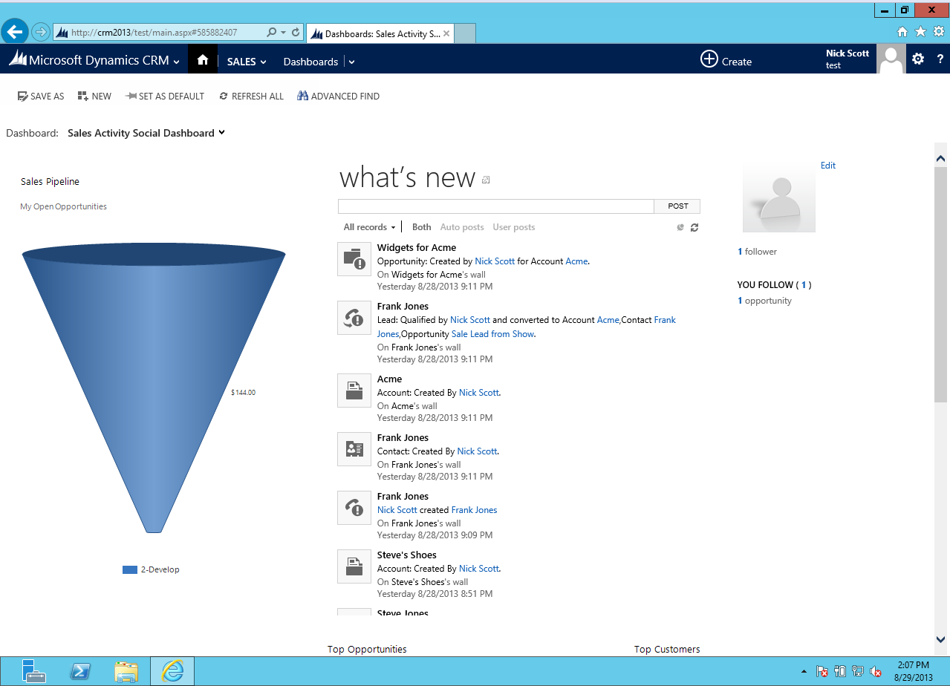
Web Client
Notes:
Web Client
Supported Browsers
Internet Explorer
Firefox
Chrome
Safari (on Apple OS)

Slide 13
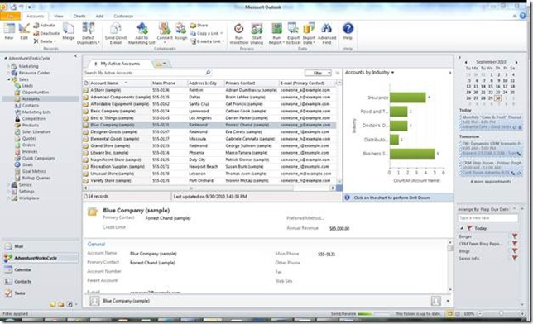
Outlook Client
Notes:
Outlook Client
Integrated to Outlook
No need to open a new window
Emails, Tasks, appointments and Contacts created in Outlook can be synched with Dynamics CRM and vice versa
Offline capability

Slide 14
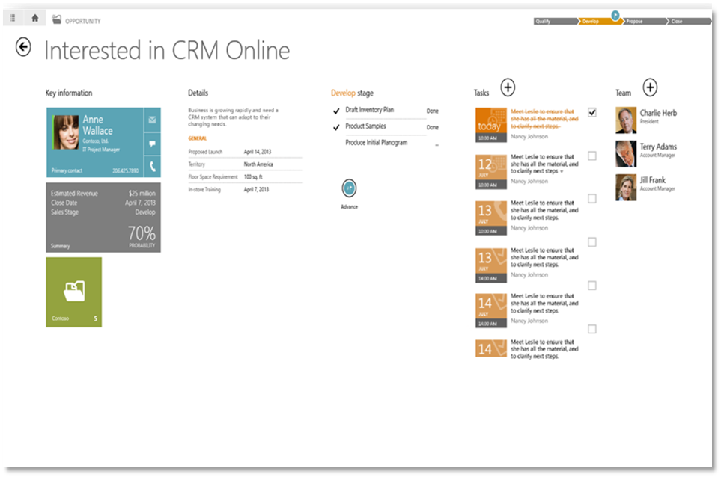
Mobile Client
Notes:
In this lesson we went over
The three deployment options
On-premise
Cloud
Partner hosted
The options for accessing CRM
Web
Outlook
Mobile/Tablet applications

Slide 15







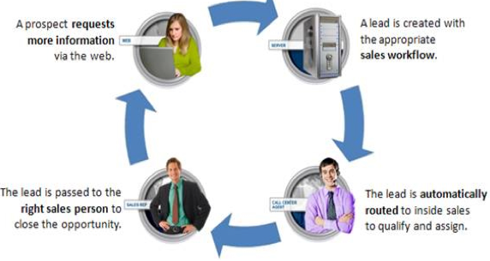



OOB (Out Of Box) features of Microsoft CRM
Field
Entity
Record
Form
Contact
Notes:
Entity: A Record type. Account, Contact, Order, etc.
Field: A single data point relating to an entity. Name, Phone number, job title, etc. Additional fields can be added.
Form: A collection of fields for one kind of entity presented so that data can be entered or modified.
Record: A single instance of an entity and the related data the fields. John Johnson, ABC Company.

Slide 16



Dynamic CRM various Versions
Microsoft Dynamic CRM 4.0
Microsoft Dynamic CRM 2011
Microsoft Dynamic CRM 2013
Microsoft Dynamic CRM 2015

Slide 17
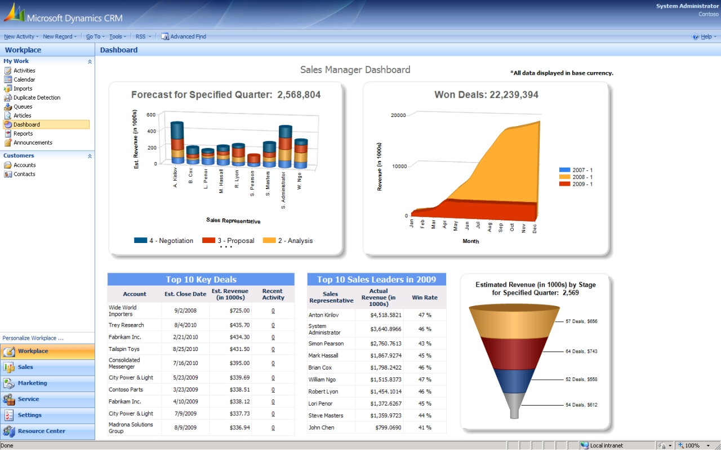
Microsoft Dynamic CRM 4.0 UI

Slide 18
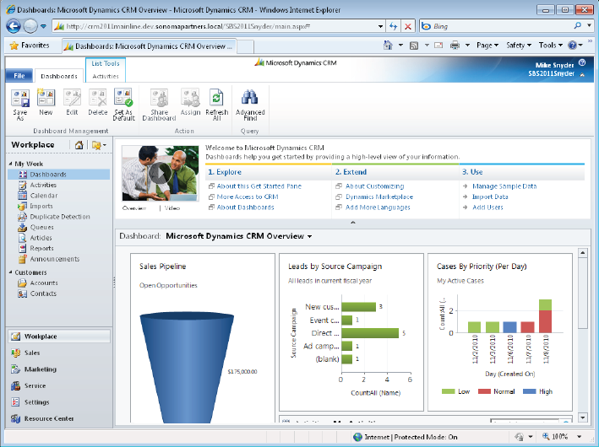
Microsoft Dynamic CRM 2011 UI

Slide 19
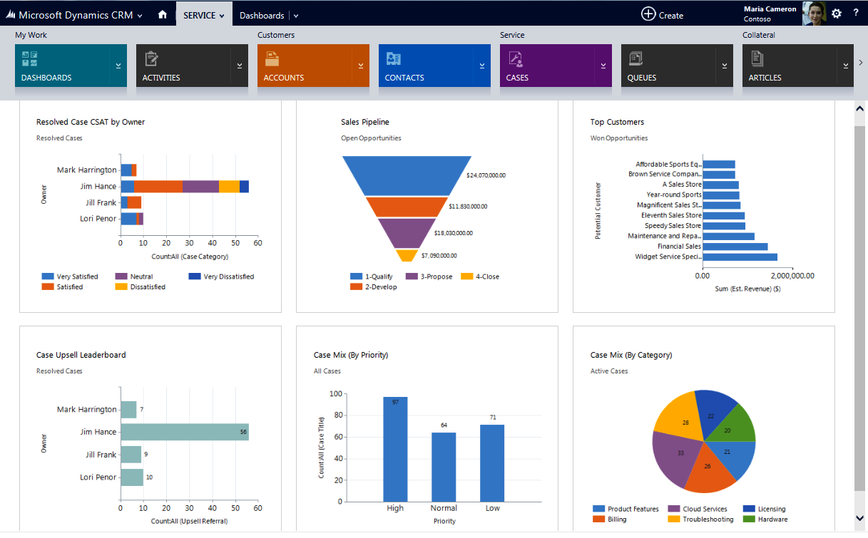
Microsoft Dynamic CRM 2013 UI

Slide 20
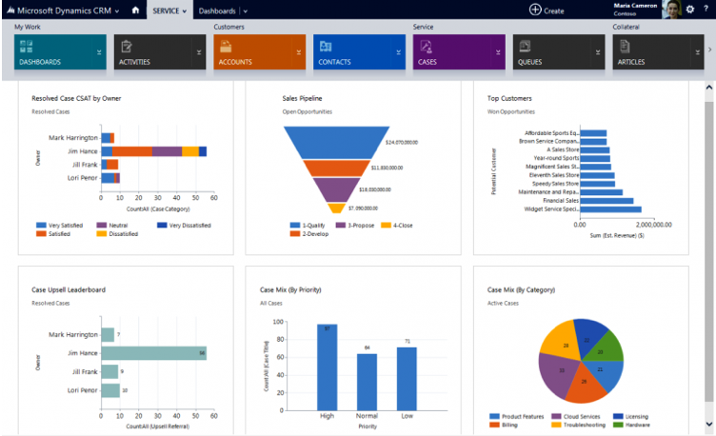
Microsoft Dynamic CRM 2015 UI

Slide 21

Security Levels in Dynamic CRM
Field Level Security - Control users and team access rights to specific fields on entities.
Role Based Security - Control users and team access rights to specific entities.
Form Based Security- Control users and team access rights to specific forms of entities.
Object Based Security- Control users and team access rights to specific records of entities.

Slide 22
Technologies Supporting Microsoft CRM
Microsoft CRM integrates and works with the following technologies
Microsoft CRM
.NET Technologies
IIS
Active Directory
SQL Server & SRS
Microsoft Exchange*

Slide 23
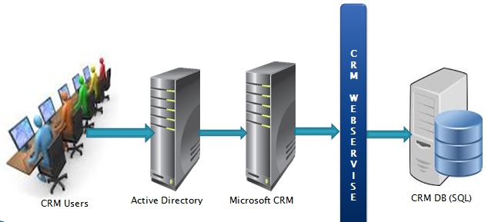
Execution Pipeline of Dynamic CRM

Slide 24

Database Structure of Dynamic CRM
Microsoft CRM Database:
MSCRM_Config – Store configuration data of crm organization.
<OrganinsationName>_MSCRM (OwensCorning_MSCRM) – Store organization metadata
Microsoft CRM Database Tables :
Base Table – Store OOB field data
Extension Table – Store custom field data

Slide 25
Real World Example of Microsoft Dynamic CRM “ABC Project Training Enrolment System”
Requirement :
ABC wants to automate our campaigning process for the project training program In all over India.
ABC wants to store students basic and address information those are participating in training.
ABC wants to store all existing student data who attended training last year.
ABC wants to keep students Query/Complaints regarding project training.
ABC wants to show all training attended students details on separate ‘Student Project Training Portal ‘
ABC wants to send notification at regular interval to get in touch with all students or to provide all updates of training schedule through Email/SMS/Phone Call.

Slide 26
Thank You!!
Any Question ???

